Slide 1
Basic moral lessons in the light of Surah Al-Hujurat سورۃ الحجرات

Slide 2
Introduction to Surah Al-Hujurat (The Chambers)
It is the forty-ninth (49) Surah By Tilawat of the Holy Quran.
106 By Reveal
It is a Madni Surah and had been revealed on several occasions that needed social guidance.
It addresses the ethical values and Akhlaq that a believer has to possess to lead an ideal life according to the principles of Islam.

Slide 3
Introduction to Surah Al-Hujurat (The Chambers) (continued)
Surah Hujarat deals with the moral values prevailing in an Islamic society. It can be divided into three parts.
The first part addresses the fact that respect should be given to our Prophet Muhammad PBUH and our opinions should be according to the commands of Allah and His messenger
The second part deals with the moral values that a believer should be possessing. He should always be ready to make peace between people with justice and equity. He should avoid making false assumptions about others and never spy on his brothers. He should stay away from backbiting and insulting.

Slide 4
Surah Al-Hujurat (The Chambers)
3. The last part addresses the fact that a Muslim attains Iman when he has pure faith and Taqwa in his heart. He does not recite duas from his tongue but his heart also bows in front of the Creator.

Slide 5
Lesson 1 Preference to Allah and Messenger
يَآ اَيُّـهَا الَّـذِيْنَ اٰمَنُـوْا لَا تُقَدِّمُوْا بَيْنَ يَدَىِ اللّـٰهِ وَرَسُوْلِـهٖ ۖ وَاتَّقُوا اللّـٰهَ ۚ اِنَّ اللّـٰهَ سَـمِيْعٌ عَلِـيْمٌ.
O ye who believe! Be not forward in the presence of Allah and His messenger, and keep your duty to Allah. Lo! Allah is Hearer, Knower.
The most important element of Imaan is to believe in the Oneness of Allah SWT and the finality of His Prophet Muhammad PBUH.
The believer dedicates his life to the cause of his creator. His wishes and whims are modified according to the commandments of Allah and the prophet Muhammad’s teachings.
He should never give preference to his views and opinions over what Allah and Prophet Muhammad have said.

Slide 6
continued
One day the Holy Prophet ﷺ saw Sayyidna Abud-Darda' walking in front of Sayyidna Abu Bakr ،he lectured him saying: "you are walking in front of a person who is better than you in this world and in the hereafter". Then he added: "The Sun did not rise or set on any man better than Abu Bakr ؓ in the world besides the Prophets. Therefore, scholars have ruled that teachers and spiritual guides should be treated with similar respect.

Slide 7
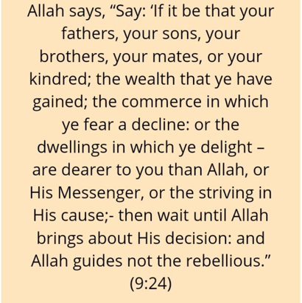

Slide 8
2nd lesson Regard For The Prophet Muhammad PBUH
يَآ اَيُّـهَا الَّـذِيْنَ اٰمَنُـوْا لَا تَـرْفَعُـوٓا اَصْوَاتَكُمْ فَوْقَ صَوْتِ النَّبِيِّ وَلَا تَجْهَرُوْا لَـهٝ بِالْقَوْلِ كَجَهْرِ بَعْضِكُمْ لِبَعْضٍ اَنْ تَحْبَطَ اَعْمَالُكُمْ وَاَنْـتُـمْ لَا تَشْعُرُوْنَ
O you who believe! Lift not up your voices above the voice of the Prophet, nor shout when speaking to him as ye shout one to another, lest your works be rendered vain while ye perceive not.

Slide 9
continued
Thus when this verse was revealed, the blessed Companions ؓ became very apprehensive and very cautious.
Sayyidna Abu Bakr ؓ said: "By God! 0 Messenger of Allah, from now till my last breath, I shall speak to you as if someone is whispering." (Ad-Durr-ul Manthur on the authority of Baihaqi)
When this verse was revealed, Sayyidna Umar's voice became so low that the Holy Prophet ﷺ had to ask him to repeat what he said, so that he could understand what he was saying to him۔ (Sihah).
Thabit Ibn Qays had a naturally loud voice. When he heard this verse, he feared that his good deeds would be rendered void, he wept and lowered his voice (Ad-Durr-ul-Manthur on the authority of Baihaqi).

Slide 10
The etiquette of being in the presence of the Holy Prophet has been laid out in the Quran.
We are not supposed to treat him like a common man or someone of equal rank.
The voice of a common man should not be raised in front of him and he should be given the utmost respect that he deserves.
In the present times, where believers do not have the opportunity to be in his presence, the same level of respect should be granted to the sayings and Message of our Holy Prophet.
One should never go against his sunnah and when his inames mentioned in front of us, we are bound to show deep reverence and love.
Ulama-e-kiram

Slide 11
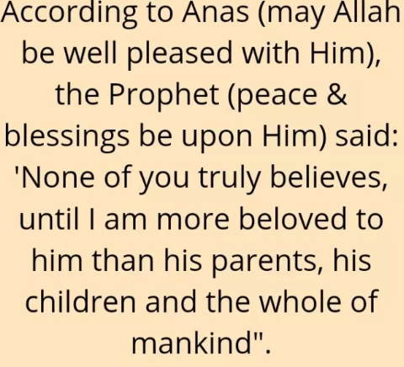

Slide 12
3rd lesson Verify The News By a Transgressor
يَآ اَيُّـهَا الَّـذِيْنَ اٰمَنُـوٓا اِنْ جَآءَكُمْ فَاسِقٌ بِنَبَاٍ فَتَبَيَّنُـوٓا اَنْ تُصِيْبُوْا قَوْمًا بِجَهَالَـةٍ فَتُصْبِحُوْا عَلٰى مَا فَعَلْـتُـمْ نَادِمِيْنَ
O you who believe! If an evil-liver bring you tidings, verify it, lest ye smite some folk in ignorance and afterward repent of what you did.
Verification of news brought by a transgressor is the most important step. Many a time, the rumor that has been traveled through someone who is a liar or false storyteller, can give rise to dreadful consequences.

Slide 13
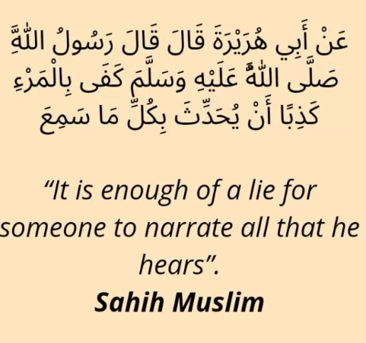

Slide 14
4th lesson Reconciliation Between People
وَ اِنۡ طَآئِفَتٰنِ مِنَ الۡمُؤۡمِنِیۡنَ اقۡتَتَلُوۡا فَاَصۡلِحُوۡا بَیۡنَہُمَا ۚ فَاِنۡۢ بَغَتۡ اِحۡدٰىہُمَا عَلَی الۡاُخۡرٰی فَقَاتِلُوا الَّتِیۡ تَبۡغِیۡ حَتّٰی تَفِیۡٓءَ اِلٰۤی اَمۡرِ اللّٰہِ ۚ فَاِنۡ فَآءَتۡ فَاَصۡلِحُوۡا بَیۡنَہُمَا بِالۡعَدۡلِ وَ اَقۡسِطُوۡا ؕ اِنَّ اللّٰہَ یُحِبُّ الۡمُقۡسِطِیۡنَ
And if two parties of the Muslims fight, make them reconcile. Then if either of these (parties) commits injustice and aggression against the other, fight against (the party) that is committing aggression till it returns to Allah’s command (of establishing peace). When they revert and submit, make peace between them with equity. And put justice to work. Surely, Allah loves those who do justice.

Slide 15
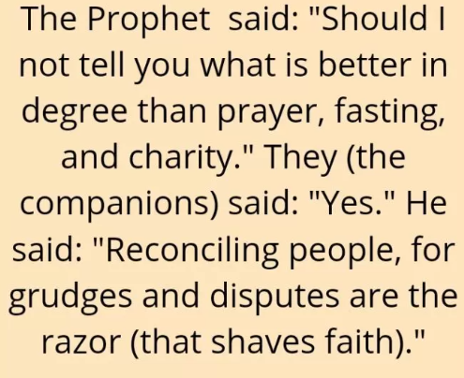
4th lesson Reconciliation Between People continued

Slide 16
5th Seeking Justice
Justice in Islam
It can only be achieved if the matters are dealt with rightfully and it also denotes fair treatment and equal distribution.
Allah in the Quran has commanded many times that we as believers should be acting justly in all matters and fair dealings should be our main priority. No relationship should hinder us from seeking justice. Allah in the Quran says,
Allah commands justice and fair dealing…” (Quran 16:90)
Similarly, when we take the responsibility of reconciliation between two individuals or parties, we are bound to examine the circumstances carefully and take appropriate measures with justice and equity.

Slide 17
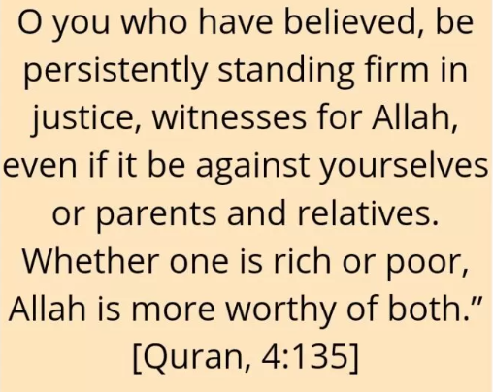

Slide 18
6th lesson All believers are but brothers
اِنَّمَا الْمُؤْمِنُوْنَ اِخْوَةٌ فَاَصْلِحُوْا بَیْنَ اَخَوَیْكُمْ وَ اتَّقُوا اللّٰهَ لَعَلَّكُمْ تُرْحَمُوْنَ۠
All believers are but brothers, therefore seek reconciliation between your two brothers, and fear Allah, so that you may be blessed with mercy.

Slide 19
7th lesson Giving Up on Mockery
یٰۤاَیُّهَا الَّذِیْنَ اٰمَنُوْا لَا یَسْخَرْ قَوْمٌ مِّنْ قَوْمٍ عَسٰۤى اَنْ یَّكُوْنُوْا خَیْرًا مِّنْهُمْ وَ لَا نِسَآءٌ مِّنْ نِّسَآءٍ عَسٰۤى اَنْ یَّكُنَّ خَیْرًا مِّنْهُنَّ١ۚ وَ لَا تَلْمِزُوْۤا اَنْفُسَكُمْ وَ لَا تَنَابَزُوْا بِالْاَلْقَابِ١ؕ بِئْسَ الِاسْمُ الْفُسُوْقُ بَعْدَ الْاِیْمَانِ١ۚ وَ مَنْ لَّمْ یَتُبْ فَاُولٰٓئِكَ هُمُ الظّٰلِمُوْنَ
O those who believe, no men should ever mock at other men, since it is possible that the latter are better than the former, nor (should) women (ever mock) at other women, since it is possible that the latter women are better than the former ones. And do not find fault with one another, nor call one another with bad nicknames. Bad is the name of sinfulness after embracing Faith. And whoever does not repent, such people are the wrongdoers.

Slide 20
continued
In Islam, every believer is equal in the eyes of Allah
But in today’s world, one who doesn’t see others with the eyes of equality considers himself better than others in terms of wealth, caste, colour and creed.
He mocks them with his words, call them names, point at their physical flaws, and never let go of any chance to insult them publicly or privately.

Slide 21
continued
According to Qurtubi, mocking or scoffing does not only connote mocking with the tongue, but it also implies mimicking someone, making pointed references to him, laughing at his words, his works, his appearance, his dress or calling people's attention to some of his defects, so that they may laugh at him. Mocking includes all of this. By the clear text of the Qur'an, poking fun at someone or ridiculing him is absolutely forbidden.

Slide 22
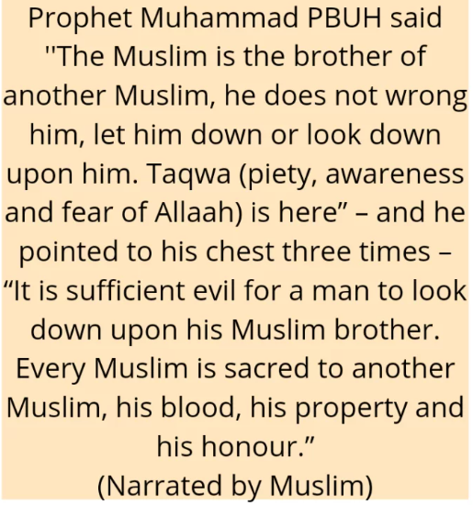

Slide 23
continued
نہ تھی حال کی جب ہمیں اپنی خبر رہے دیکھتے لوگوں کے عیب و ہنر
پڑی اپنی برائیوں پر جو نظر تو جہان میں کوئی بُرا نہ رہا
As long as we were unaware of our own faults, we looked into the faults and failings of others; But when we looked at our own faults there remained no one faulty in the world.

Slide 24
8th lesson Renouncing suspicions, finding faults and Backbiting
یٰۤاَیُّهَا الَّذِیْنَ اٰمَنُوا اجْتَنِبُوْا كَثِیْرًا مِّنَ الظَّنِّ١٘ اِنَّ بَعْضَ الظَّنِّ اِثْمٌ وَّ لَا تَجَسَّسُوْا وَ لَا یَغْتَبْ بَّعْضُكُمْ بَعْضًا١ؕ اَیُحِبُّ اَحَدُكُمْ اَنْ یَّاْكُلَ لَحْمَ اَخِیْهِ مَیْتًا فَكَرِهْتُمُوْهُ١ؕ وَ اتَّقُوا اللّٰهَ١ؕ اِنَّ اللّٰهَ تَوَّابٌ رَّحِیْمٌ
O those who believe, abstain from many of the suspicions. Some suspicions are sins. And do not be curious (to find out faults of others), and do not backbite one another. Does one of you like that he eats the flesh of his dead brother? You would abhor it. And fear Allah. Surely Allah is Most-Relenting, Very-Merciful.

Slide 25
continued
Backbiting is to mention someone in his absence in the way he would have hated to be mentioned.
It is one of the gravest sins in Islam and can only be forgiven if the person, whose gheebah has been done, forgives us.
Uttering derogatory remarks, making fun of them, in their absence that cannot be shared in their presence count Backbiting.
It is considered equal to eating one’s brother’s flesh, therefore, Allah commands us to renounce backbiting.

Slide 26
continued
لا تغتابوا المسلمین ولا تتّبعوا عوراتھم فان من اتبّع عوراتھم یتبع اللہ عورتۃ و من یتّبع اللہ عورتۃ یفضحہ فی بیتہ “
Do not speak ill of Muslims behind their backs, and do not search out their faults, for he who searches out their faults will have his faults searched out by Allah, and he whose faults are searched out by Allah will be exposed by Him, even though he should be in the interior of his house" [ Qurtubi ].

Slide 27
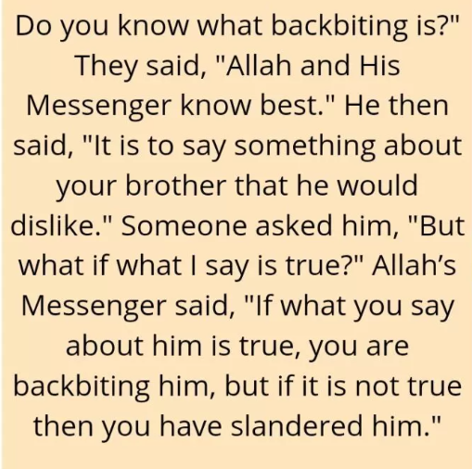

Slide 28
Suspicion is to form false assumptions about someone on the basis of their actions or giving self-formed justifications to whatever they say or do.
It is prohibited by Allah to be suspicious about other believers and find faults in them.
It corrupts one’s heart and soul with illogical explanations and thoughts and disrupts one’s relationships with others.
We should always respect the privacy of others and never ask questions about their personal lives with the intention of spying.

Slide 29
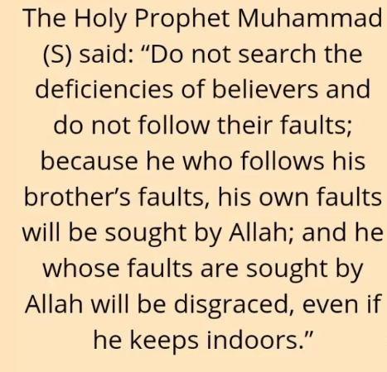

Slide 30
9th lesson Islam Negates Racism
یٰۤاَیُّهَا النَّاسُ اِنَّا خَلَقْنٰكُمْ مِّنْ ذَكَرٍ وَّ اُنْثٰى وَ جَعَلْنٰكُمْ شُعُوْبًا وَّ قَبَآئِلَ لِتَعَارَفُوْا١ؕ اِنَّ اَكْرَمَكُمْ عِنْدَ اللّٰهِ اَتْقٰىكُمْ١ؕ اِنَّ اللّٰهَ عَلِیْمٌ خَبِیْرٌ
O mankind, We have created you from a male and a female and made you into races and tribes, so that you may identify each other. Surely the noblest of you, in Allah's sight, is the one who is most pious of you. Surely Allah is All-Knowing, All-Aware.

Slide 31
continued Circumstances of Revelation
This verse was revealed on the occasion of the conquest of Makkah. When it was time for prayer, the Holy Prophet ﷺ asked Sayyidna Bilal to call the adhan. One of the pagan Quraish negatively remarked: Thank God that my father died before this happened, and he did not have to see this bad day.
Harith Ibn Hisham remarked: Could Muhammad not find anyone better than this black crow to sound the adhan in the Sacred Mosque!
Abu Sufyan said: I do not wish to utter anything for fear that the master of the heavens will inform him. Thus Jibra'il (علیہ السلام) came down and informed the Holy Prophet ﷺ about this conversation. The Holy Prophet ﷺ called them and asked them about it. They admitted. At this, the current verse was revealed.

Slide 32
continued
Racism is having prejudices against one race, cast or an individual and treating them unequally in an inferior or superior manner.
In Islam, racism is considered a heinous act that breaks apart societies.
We have been created from one dust and one Creator, Allah, and we are the offspring of one father and mother.
On the day of Resurrection, Allah will not ask us about our tubes or nationality.

Slide 33
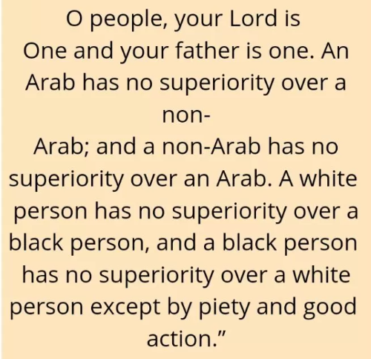

Slide 34
10th lesson Taqwa, the Main Element of Islam
Entering the circle of Islam demands complete obedience and Taqwa.
Just reciting Kalma for the sake of being a Muslim is not what Islam is about.

Slide 35
